Slide 1
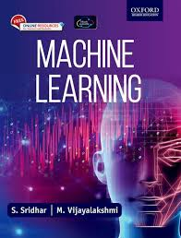
Machine Learning

Slide 2
Chapter 1
Introduction to Machine Learning

Slide 3
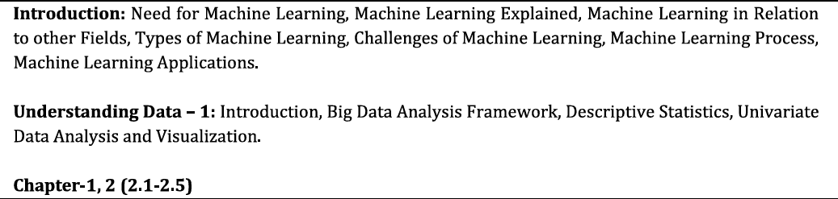
Content

Slide 4
Need for Machine Learning?
1. BUSINESS ORGANIZATIONS HAVE NUMEROUS DATA
Companies generate huge volumes of data
Humans cannot analyze this manually
Storage is cheap, data is everywhere
Real-life Example:
Bank → millions of transactions/day
Question: Which transactions are fraud?
👉 Impossible with IF–ELSE rules
Key message:
➡ ML helps convert data into decisions
2.NEED TO ANALYZE DATA FOR TAKING DECISIONS

Slide 5
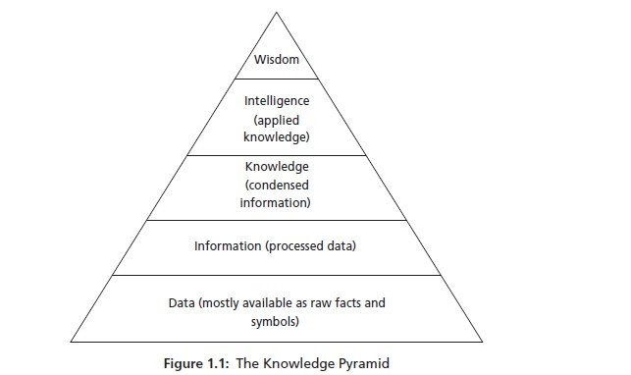
Need for Machine Learning?
Knowledge pyramid
Machine Learning is not about coding first. It is about understanding how raw data becomes intelligent decisions. This pyramid explains that journey.
ML works mainly in the middle layers (Information → Knowledge → Intelligence)

Slide 6
Data
What is Data?
Raw facts
No meaning by itself
Can be numbers, text, images, signals
ML Perspective:
Input to any ML algorithm
Usually messy, incomplete, noisy
Example:- Example (Running Example – Student Marks):
85, 72, 90, 40, 55
Ask students:
“Can you say who passed or failed?”
👉 No
More ML Examples:
Sensor readings
Click logs
Images pixels
Network packets (relevant to your CN background)
Key sentence for PPT:
Data is raw fuel. Alone, it cannot drive decisions.

Slide 7
Information
What is Information?
Data + processing (Processed Data)
Organized, structured
Answers what happened
Processing Examples:
Sorting
Filtering
Aggregation
Cleaning
Same Example (Student Marks):
Marks ≥ 50 → Pass Marks < 50 → Fail
👉 Now data has meaning
Marks | Result
85 | Pass
72 | Pass
90 | Pass
40 | Fail
55 | Pass
ML Connection:
Feature extraction
Preprocessing step
Data preparation phase
📌 One-liner:
Information tells us what, not why.

Slide 8
INTELLIGENCE (Applied Knowledge)
What is Intelligence?
Using knowledge to make decisions
Predicting unseen outcomes
Taking actions
Example:
Based on past results:
“This student is at risk of failing next semester”
ML Examples:
Spam detection
Fraud prediction
Disease diagnosis
Network intrusion detection
Knowledge | Intelligence
Patterns found | Patterns used
Offline learning | Real-time decision
Past data | Future prediction
📌 Exam-friendly line:
Intelligence is knowledge in action.

Slide 9
WISDOM (Top of Pyramid)
What is Wisdom?
Ethical, long-term decision making
Context + experience + intelligence
Example:
Instead of just predicting failure:
“Provide extra classes and counseling to improve performance”
In AI/ML Context:
Human-in-the-loop
Policy decisions
Ethical AI
Important Note for Students:
⚠️ Machines have very limited wisdom
Humans still dominate this layer.
📌 One-liner:
Wisdom decides what should be done, not just what can be done.

Slide 10
Mapping Pyramid to Machine Learning
Pyramid Layer | Role in ML
Data | Training dataset
Information | Pre-processed features
Knowledge | Learned model
Intelligence | Predictions
Wisdom | Human decisions
“Machine Learning transforms data into intelligence, but wisdom still belongs to humans.”

Slide 11
Example
Knowledge Pyramid – Simple Example
Example: Student Marks
1.Data
  Raw marks: 45, 78, 62, 90, 33, 55
  Just numbers, no meaning
2.Information
  Rule applied:
    Marks ≥ 50 → Pass
    Marks < 50 → Fail
  Data becomes meaningful
3.Knowledge
  Pattern observed:
    Students scoring below 50 usually fail
    Higher marks → better performance
✔ Shows how raw data is converted into understanding

Slide 12
Example
How Machine Learning Uses the Pyramid
Data → Training data
  Past student marks
Information → Pre-processed data
  Cleaned marks + pass/fail labels
Knowledge → Learned ML model
  Model learns pass/fail pattern
Intelligence → Prediction
  New mark = 48 → Likely Fail
Wisdom → Human decision
  Teacher provides extra classes
👉 Machine predicts, humans decide
Machine Learning converts data into predictions, but wisdom remains with humans.

Slide 13
Popularity for Machine Learning
HIGH VOLUME OF DATA
REDUCED COST OF STORAGE
AVAILABILITY OF COMPLEX ALGORITHMS AND TOOLS

Slide 14
HIGH VOLUME OF DATA
Today, data is generated every second from mobiles, social media, sensors, and networks
Examples:
WhatsApp messages, Instagram photos
Network logs in organizations
Online exams, attendance systems
Why ML?
Humans cannot analyze millions of records
ML can learn patterns from huge datasets
📌 Without big data, ML cannot learn well.

Slide 15
REDUCED COST OF STORAGE
Earlier, storing data was expensive. Today, cloud storage is cheap.
Examples:
Google Drive, AWS, Azure
Colleges storing years of student data
Hospitals storing patient records
Why ML became popular?
Data can be stored for long periods
Old data helps train better ML models
📌 More stored data → better learning.

Slide 16
AVAILABILITY OF COMPLEX ALGORITHMS AND TOOLS
We don’t write ML algorithms from scratch anymore.
Examples of tools:
Python
Scikit-learn
TensorFlow, PyTorch
Simple explanation:
Algorithms are already available
Anyone can build ML models with minimal coding
📌 ML became popular because it is now accessible.

Slide 17
Popularity for Machine Learning
Machine Learning became popular because we have huge data, cheap storage, and powerful algorithms.

Slide 18
Question Time
If we had big data but no storage, would ML work?

Slide 19
Answer Time
No, Machine Learning would not work effectively if we had big data but no storage.
Machine Learning requires large amounts of data to be stored so that it can be processed, analyzed, and used repeatedly for training models.
Without storage, data cannot be preserved for learning, and accurate models cannot be built.
Therefore, big data, cheap storage, and powerful algorithms must work together for Machine Learning to be successful.
Big data without storage is useless for Machine Learning.

Slide 20
What is Machine Learning?
MACHINE LEARNING IS A FIELD OF STUDY THAT GIVES THE COMPUTERS TO LEARN WITHOUT BEING EXPLICITLY PROGRAMMED
In traditional programming:
  We write rules
  Computer follows those rules
In Machine Learning:
  We do not write rules
  We give data
  Computer learns rules by itself
📌 Key idea:
Learning from experience, not instructions.

Slide 21
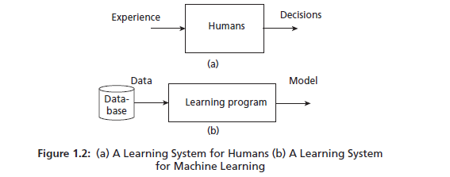
What is Machine Learning?

Slide 22
What is Machine Learning?
(a) Learning System for Humans
Flow:
Experience → Human → Decisions
Example:
A student solves many problems
Gains experience
Makes better decisions in exams
👉 Humans learn from experience
(b) Learning System for Machine Learning
Flow:
Data → Learning Program → Model → Decisions
Explain each block clearly:
🔹 Data
Past records
Examples
Training dataset
Example:
Student marks, emails, images, network logs

Slide 23
What is a Model?
A model is a simplified representation of the real world.
It helps us understand, explain, or predict how something works without dealing with all real-world complexity.
👉 In Machine Learning, a model is what learns from data and makes decisions or predictions.

Slide 24
Example
What is the model here?
Think of the model like a rule-maker.
Input (Data):
  Attendance %
  Internal marks
  Assignment performance
Model’s job:
  Learn the relationship between these inputs and final marks
  Example learning:
    High attendance + good internals → High final marks
    Low attendance → Lower marks
Output (Prediction):
  Predicted final exam score
A model is a simplified representation
→ We don’t consider everything (sleep, mood, weather), only important factors.
It helps us understand and predict
→ “If attendance improves, marks usually improve.”
In Machine Learning:
👉 The model learns from past student data and predicts marks for a new student.

Slide 25
What is a Model?
A MODEL CAN BE ANY ONE OF THE FOLLOWING –
MATHEMATICAL EQUATION
RELATIONAL DIAGRAMS LIKE GRAPHS/TREES
LOGICAL IF/ELSE RULES
GROUPINGS CALLED CLUSTERS

Slide 26
Mathematical Equation
Uses formulas to represent relationships between inputs and outputs
Example:
Final Marks = 0.6 × Internal + 0.4 × External
Used in ML: Linear Regression

Slide 27
RELATIONAL DIAGRAMS LIKE GRAPHS/TREES
Represents decisions in a flow or hierarchy
Example:
Decision Tree for loan approval or exam result
Used in ML: Decision Trees, Random Forest

Slide 28
Logical IF–ELSE Rules
Uses conditions to make decisions
Example:
IF attendance ≥ 85% → Eligible
ELSE → Not eligible
Used in ML: Rule-based systems, Expert systems

Slide 29
Groupings Called Clusters
Groups similar data without predefined labels
Example:
Grouping students as high, average, and slow learners
Used in ML: K-Means Clustering, Hierarchical Clustering

Slide 30
A model is not just code — it can be a formula, rule, diagram, or grouping that helps machines make sense of data.

Slide 31
Question Time
Which model type would you use to predict marks, and which to group students?

Slide 32
Question Time
A model can be represented in different forms such as:
Mathematical equations – to show relationships between variables
Relational diagrams (graphs/trees) – to represent decision flow
Logical IF–ELSE rules – to make rule-based decisions
Clusters – to group similar data points together
In Machine Learning, a model learns from data and uses these representations to make predictions or decisions.

Slide 33

Another view of Machine Learning
TOM MITCHELL DEFINITION OF MACHINE LEARNING

Slide 34
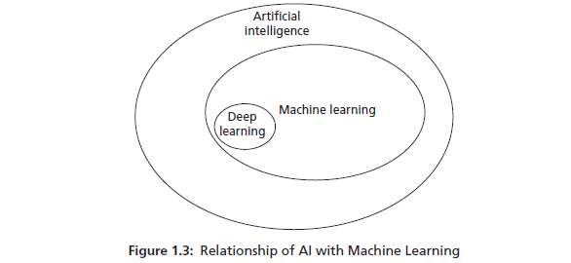
MCHINE LEARNING AND AI
RELATION BETWEEN MACHINE LEARNING AND AI

Slide 35
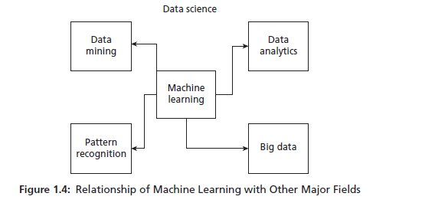
Machine Learning and Data Science
DATA SCIENCE IS AN “UMBRELLA TERM” COVERING FROM DATA COLLECTION TO DATA ANALYSIS.
Machine Learning connects and supports Data Mining, Pattern Recognition, Data Analytics, and Big Data within the broader field of Data Science.

Slide 36
Machine Learning and Data Science
At the center of the diagram is Machine Learning.
This shows that ML is a core technique used by many related fields inside Data Science.
1️⃣ Data Mining
Focuses on discovering useful patterns from large datasets
Example:
  Finding buying patterns in supermarket data
Machine Learning helps by automating pattern discovery

Slide 37
Machine Learning and Data Science
At the center of the diagram is Machine Learning.
This shows that ML is a core technique used by many related fields inside Data Science.
2️⃣ Pattern Recognition
Focuses on identifying patterns in data
Example:
  Handwritten digit recognition
  Face recognition
Machine Learning is the main engine behind pattern recognition

Slide 38
Machine Learning and Data Science
At the center of the diagram is Machine Learning.
This shows that ML is a core technique used by many related fields inside Data Science.
3️⃣ Data Analytics
Focuses on analyzing data to get insights
Example:
  Sales trends
  Student performance analysis
Machine Learning adds prediction and automation to analytics

Slide 39
Machine Learning and Data Science
At the center of the diagram is Machine Learning.
This shows that ML is a core technique used by many related fields inside Data Science.
4️⃣ Big Data
Deals with huge volume, velocity, and variety of data
Example:
  Social media data
  IoT sensor data
Machine Learning is used to analyze big data efficiently

Slide 40
Data Science is the complete process of working with data, and Machine Learning is the core technique that enables systems to learn from data and make predictions.

Slide 41
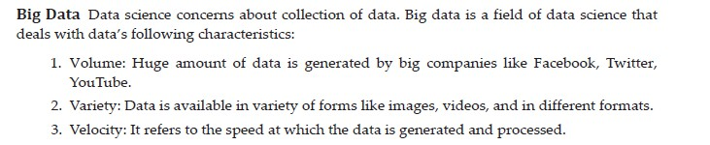
Machine Learning and Data Science
CHARACTERISTICS OF BIG DATA

Slide 42
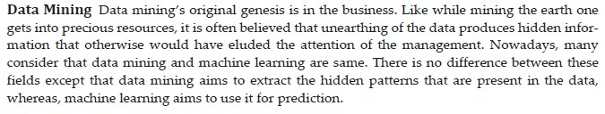
Machine Learning and Data Science
DATA SCIENCE AND DATA MINING

Slide 43
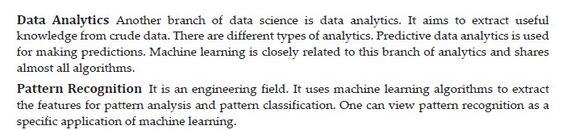
Machine Learning and Data Science
DATA SCIENCE AND DATA ANALYTICS / PATTERN RECOGNITION

Slide 44

Machine Learning and Statistics
ROLE OF STATISTICS

Slide 45
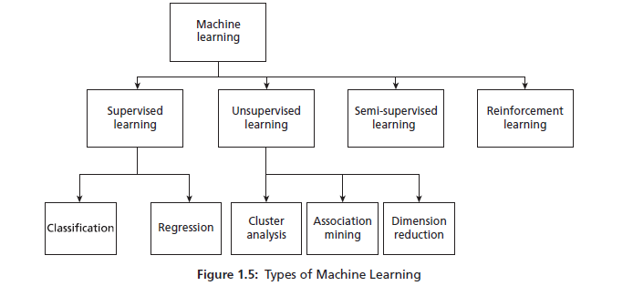
Machine Learning Types

Slide 46
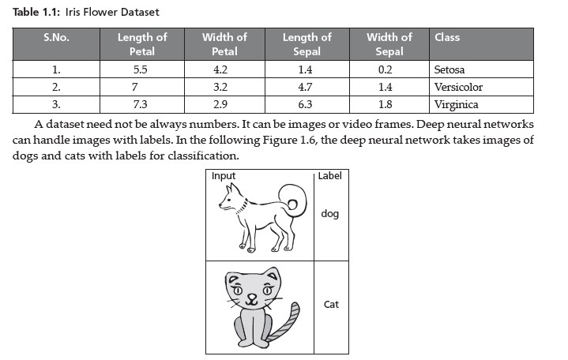
Labelled Data

Slide 47

Unlabeled Data
DATA THAT IS NOT ASSOCIATED WITH LABELS ARE CALLED UNLABELLED DATA

Slide 48
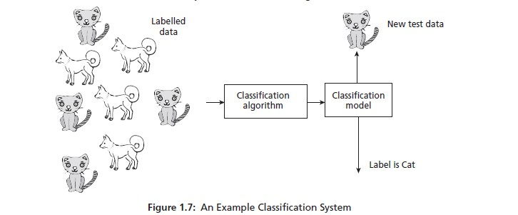
Supervised Learning
CLASSSIFICATION

Slide 49
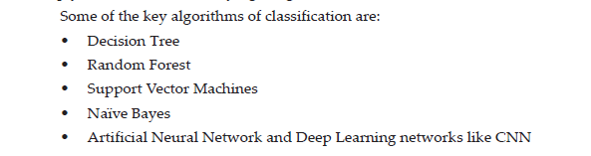
Supervised Learning
KEY ALGORITHMS

Slide 50
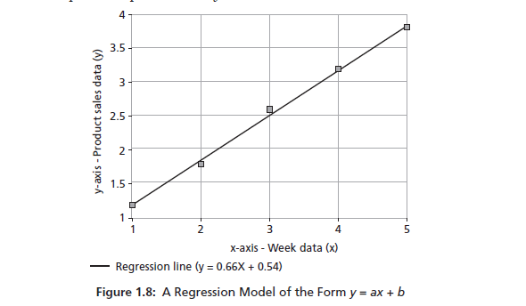
Supervised Learning
REGRESSION ALGORITHMS
Regression is used when the output is a continuous value
Example outputs:
Sales amount
Temperature
Salary
Marks
In supervised learning, regression models learn from past labeled data and predict continuous future values using a mathematical equation.

Slide 51
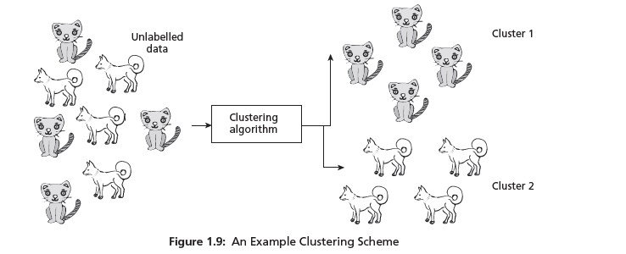
Unsupervised Learning
CLUSTERING IS GROUPING PROCESS

Slide 52

Unsupervised Learning
KEY ALGORITHMS OF UNSUPERVISED LEARNING

Slide 53
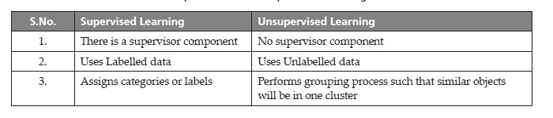
Key Differences

Slide 54

Semi-supervised Learning

Slide 55
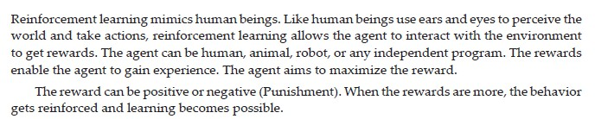
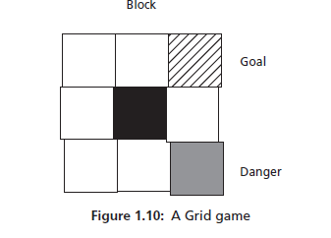
Reinforcement Learning

Slide 56
Challenges of Machine Learning
ILL-POSED PROBLEMS – PROBLEMS WHOSE SPECIFICATIONS ARE NOT CLEAR
HUGE DATA
HUGE COMPUTATION POWER
COMPLEXITY OF ALGORITHMS
BIAS-VARIANCE

Slide 57
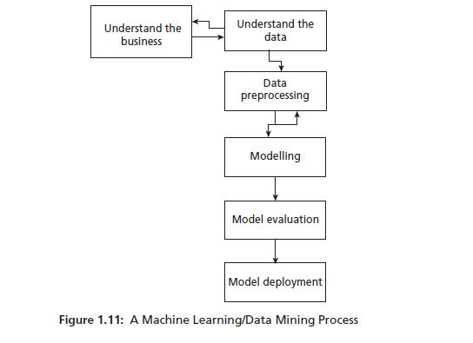
Machine Learning Process
MACHINE LEARNING/DATA MINING PROCESS

Slide 58
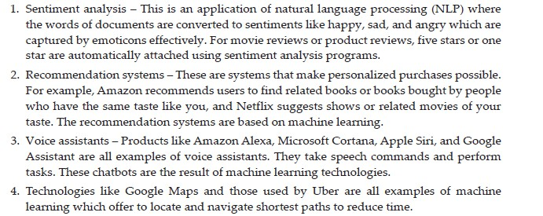
Machine Learning Applications
MACHINE LEARNING MAJOR APPLICATIONS

Slide 59
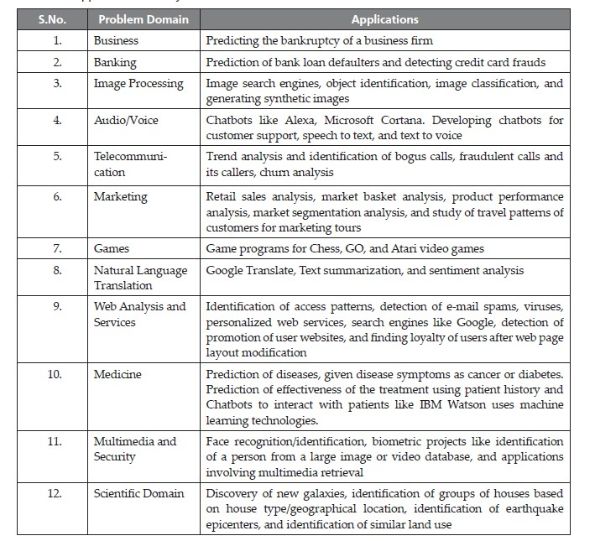
Machine Learning Applications
MACHINE LEARNING MAJOR APPLICATIONS

Slide 60
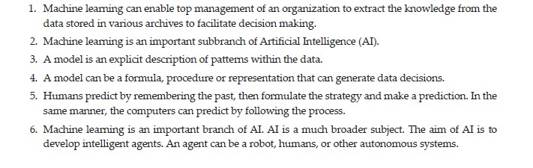
Summary

Slide 61
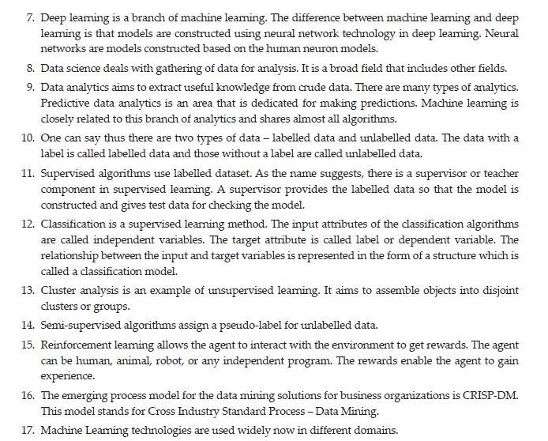
Summary

